Slide 1
Optimizing Recombinant Protein Titer Production in Escherichia coli Fermentations using Interpretable Machine Learning
Presented by:
Paul Okafor
March 15th, 2024
Notes:
-Take your time
-Get the words right
-Anunciate

Slide 2

Outline
Introduction
Data Variables
Data Exploration
Data Variants
Model Design
Results
Conclusion
Notes:
-Mammalian, Bacteria, Yeast, or Insect
-Mammalian cells take longer
-CHO is fascinating, but very common in recombinant protein production industry

Slide 3
Introduction
Escherichia coli (E. coli) in Biotechnology
Problem Definition
Optimization Challenges:
Rely on expert opinion
Hard to manage variables: temperature, pH, nutrients
Results in suboptimal yields & inefficiencies.
Adoption of Machine Learning:
This research aims at the integration of interpretable machine learning models into decision support system,
Rapid growth & simple nutrition
Broad applications: pharmaceuticals, enzymes
Easy genetic manipulation
Cost-effective
Notes:
Must format data first

Slide 4
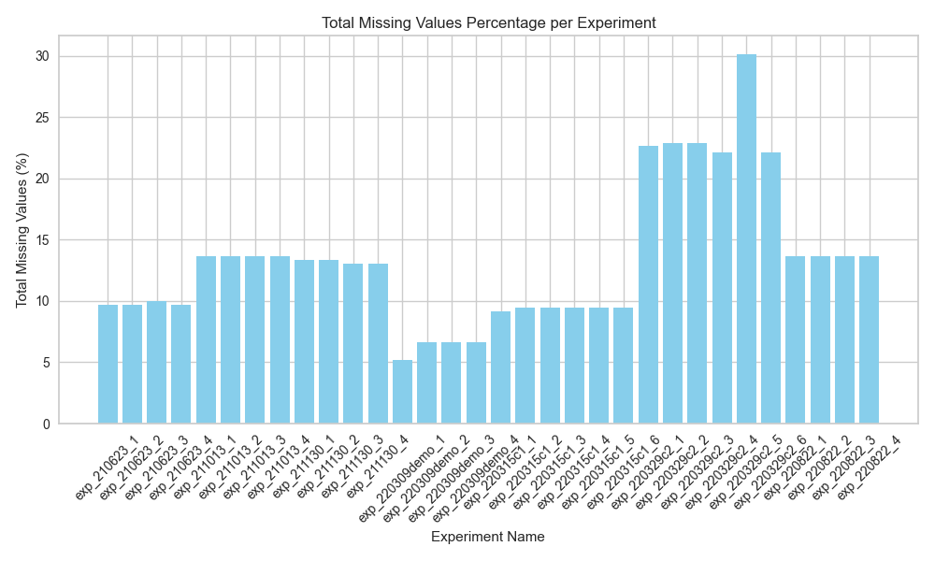
Data Ingestion
Cytovance experimental data
Given data via Microsoft Excel
7 “sheets” across 2 files
32 Total batches
15 input variables
17 output variables
Issues during Ingestion
Invariate Features (Input Variables)
Titer values not recorded at each timepoint.
Data format inconsistent ('±' and '%’)
Percentage of Missing value across batches

Slide 5
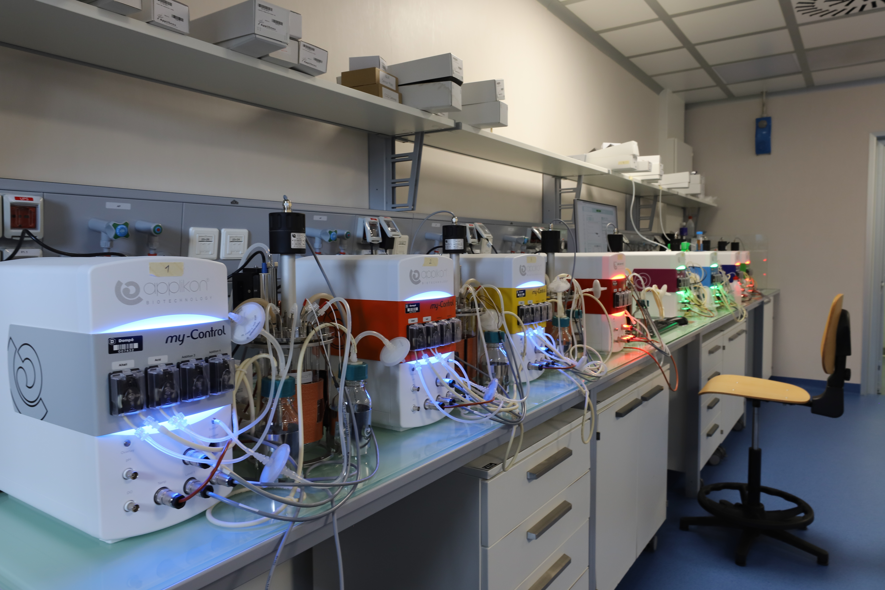
Data Variables
Input variables
Vessel Type (5L Fermenter)
Vessel Volume (500 ml)
Vessel Name (Ferm1)
Production Day (1 or 2)
Timepoint (0 - 48 hours)
Agitation (1185 rpm)
Dissolved Oxygen (100 %)
pH (6.3)
Gas Flow (5.0)
Air (100 %)
Oxygen (0)
Temperature (30 ºC)
Media Type (Media Type)
Feed Type (Glucose)
Glucose Limit (0)

Slide 6
Data Variables
Output variables
Optical Density (OD600nm)
Wet Cell Weight (g/L)
Titer (mg/ml)
Glycerol (g/L)
Glucose (g/L)
Acetate (mmol/L)
Phosphate (mmol/L)
+ Input variables

Slide 7
Data Exploration

Slide 8
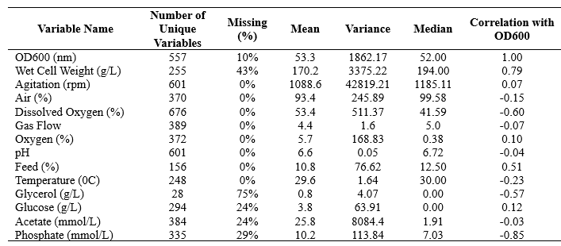
Data Exploration
Initial Data Preprocessing:
Extract individual batches
Clean inconsistent data format ('±’ and ‘%’)
Rename appropriate columns
Standardize column order
Data Quality Report
Titer values discarded
OD600nm is target variable
Inputs Data Quality Report
Notes:
Must format data first

Slide 9
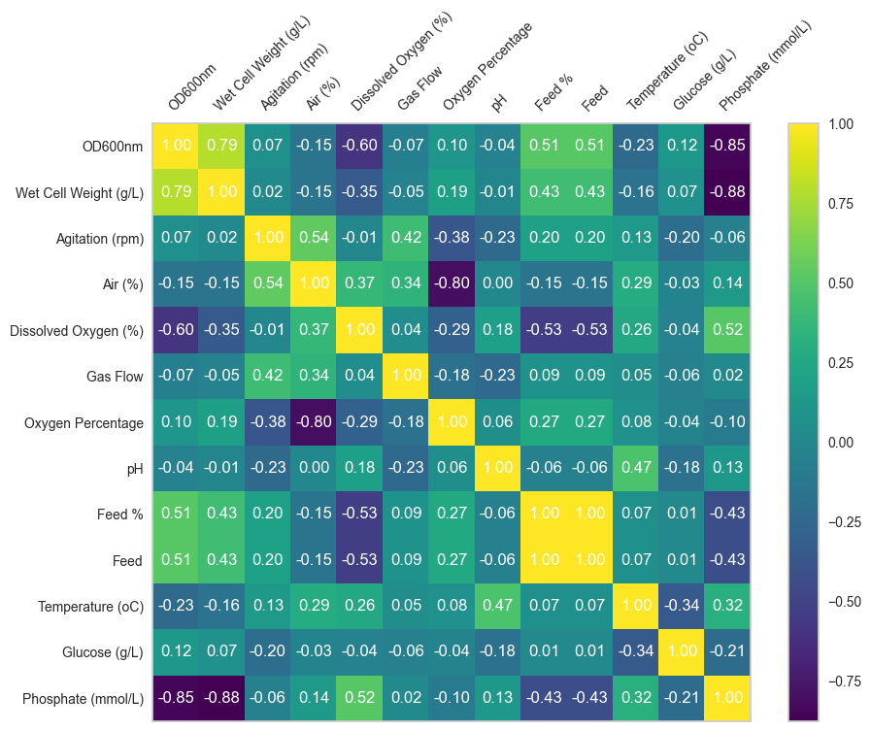
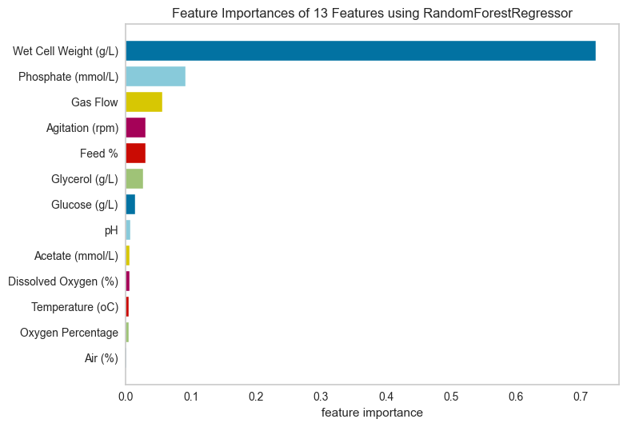
Data Exploration
Feature Analysis through Correlation Analysis and Ranking
Top 4 predictors of OD600nm are Wet Cell Weight (g/L), Phosphate (mmol/L), Gas Flow, and Agitation (rpm)
OD600nm has a moderate-high correlation with Wet Cell Weight (g/L) and Feed (%)

Slide 10
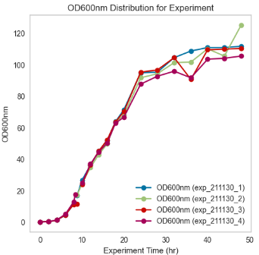
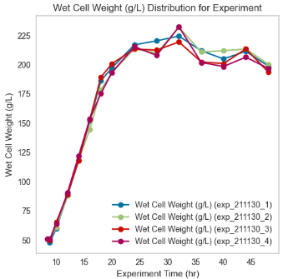
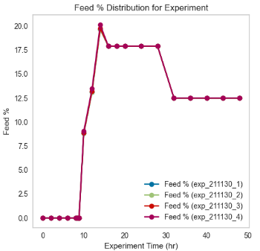
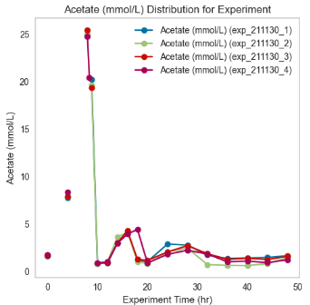
Data Exploration
Timeseries Plots of Key Variables
The feed contains 50% glucose solution.
When Acetate production > 5mmol/L, we add more feed
Protein expression levels performed poorly for batches in 220329c2, and 220315c1

Slide 11
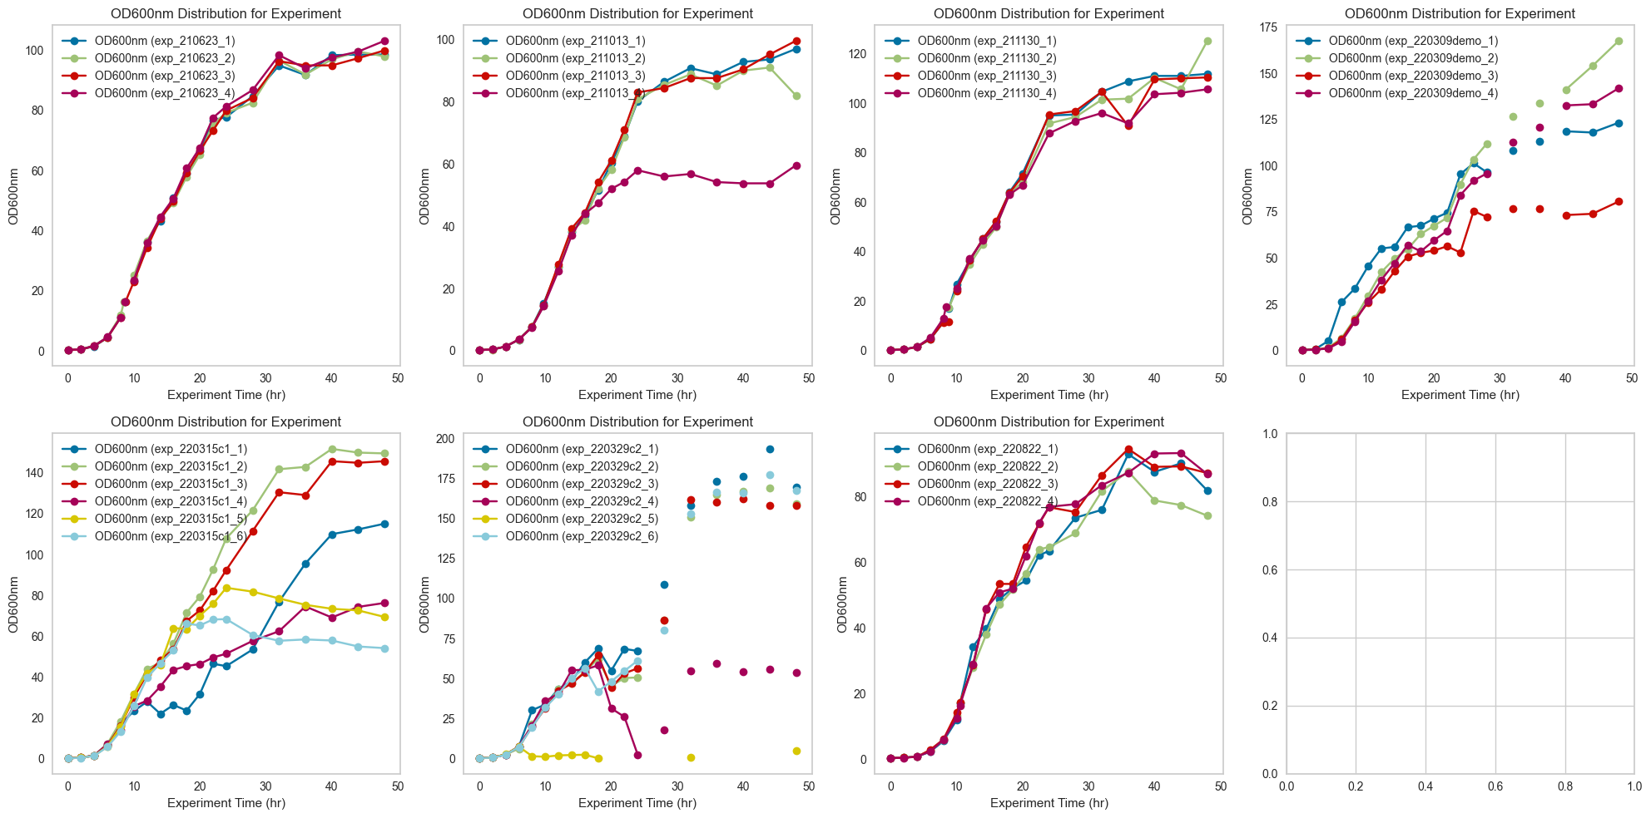
Data Exploration
Timeseries Plots of OD600nm
Experiments 210623, 211013, 211130, and 220309_demo batch groups had good OD600nm >= 100.
220315c1 and 220329c2 had average-poor OD600nm as a result of variations in agitation and acetate production.
220822 batches had OD600nm <= 90

Slide 12
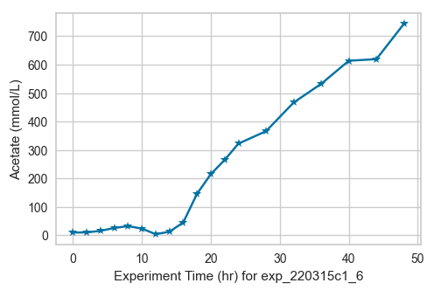
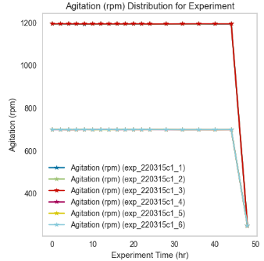
Data Exploration
Identifying Several Anomalies in the Data
Agitation (rpm) ranged from either 700 rpm or 1200 rpm.
Agitation of 700 rpm had the lowest OD600nm across batches.
Acetate production reached 700 mmol/L for 220315c1 and 220329c2 batches (with agitation = 700 rpm).

Slide 13
Data Variants
Data 1
Data 2
Data 3
This is the entire concatenated dataset batches.
Removed batches with Agitation 700 rpm and low optical density
Removed all batches in 220329c2. These batches had too many missing data
Data 4
Data 5
Data 6
Removed all batches in 220329c2 and Glycerol variable. These had too many missing data
Only batches with Agitation of 1200 rpm.
This is the entire dataset without Glycerol variable.

Slide 14
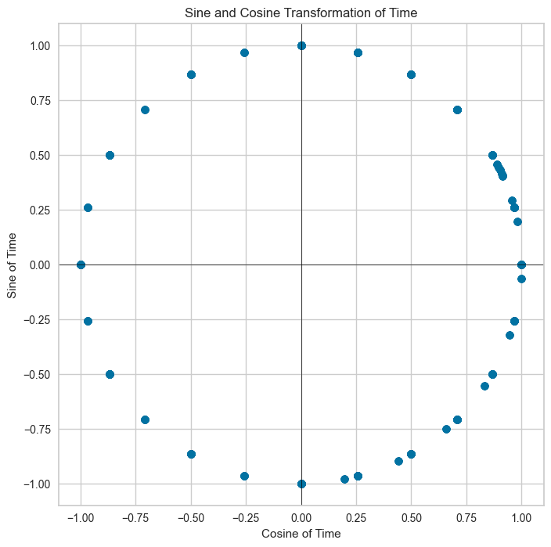
Time as a Variable
Captures Cyclical Nature: Maps linear time to a circle, preserving cyclical patterns like days in a week or hours in a day. (Time = 48 hours)
Sine & Cosine Functions: Create two dimensions, ensuring continuity (e.g., midnight close to 11 PM).
Enhances Analysis: Improves pattern recognition in cyclical data for time series forecasting and seasonal trends.

Slide 15

Feature Extraction and Selection
Feature Extraction (Polynomial Feature Extraction):
Extracted relationships from key features
Feature Selection I (Recursive Feature Elimination (RFE):
Eliminates features iteratively using Random Forest estimator (20% eliminated).
Ranks features based on model performance impact
Feature Selection II (SelectFromModel):
Selects features based on predefined importance thresholds using Random Forest estimator (50% eliminated).
24 features remaining after Feature Selection

Slide 16
Model Design

Slide 17
Model Design and Validation – Predictive Model
Model Selection
Process Validation
Split Train/Validate
Train Model
Test Model Tune
Cross-Validation / Random shuffling
Train and tune a variety of models 10 times
Random Forest Regression
Gradient Boosted Trees
Multivariate Adaptive Regression Splines
Seasonal Arima
Linear Model
Evaluate each tune on the same test set
Various machine learning methods attempted previously [1][2]
Attempting to find which produces a significantly better RMSE
Repeat n =10 times

Slide 18
Results

Slide 19
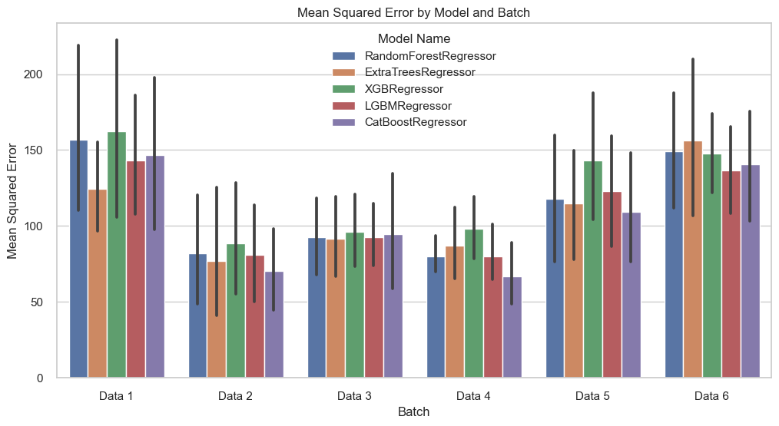
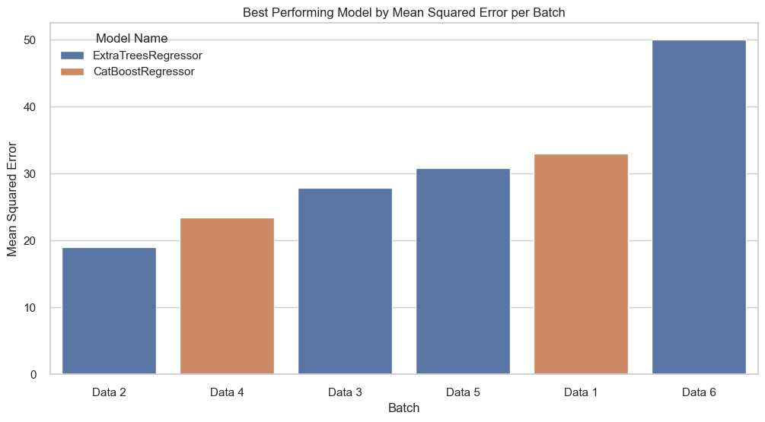
Results
Best performing Data Variants:
Data 2: Removed batches with Agitation 700 rpm and low optical density
Data 3: Removed all batches in 220329c2.
Data 4: Removed all batches in 220329c2 and Glycerol variable
Best performing Models:
ExtraTreesRegressor (Data 2)
MSE: 18.99
RMSE: 4.36
R Square: 0.988

Slide 20
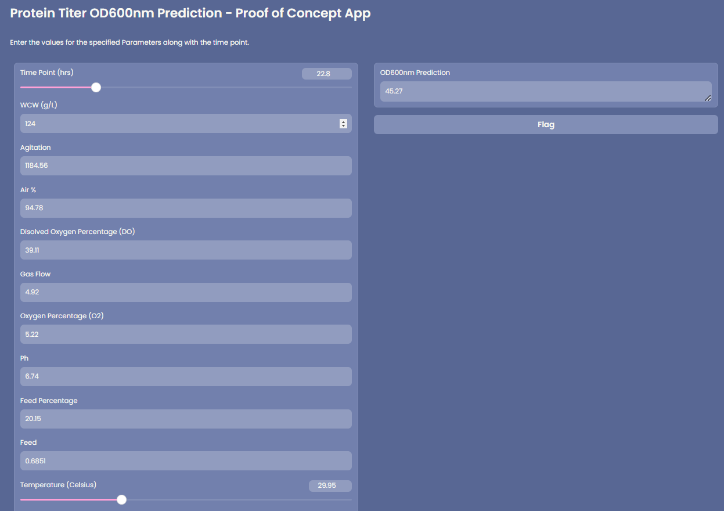
Proof of Concept App

Slide 21

Proof of Concept

Slide 22
Future Direction

Slide 23
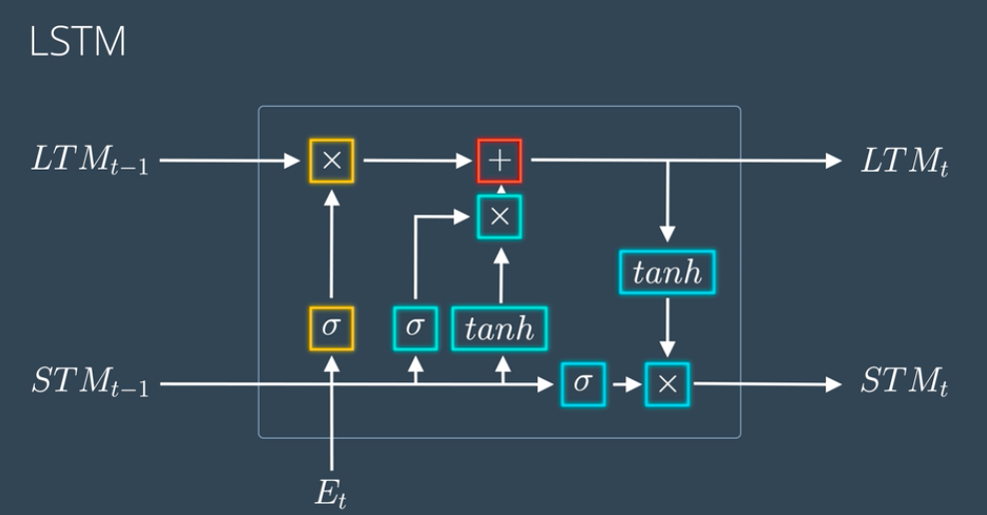
Future Direction
Synthetic Data Generation (in Minutes)
Utilize full historical sequences for richer context in forecasting target at time t:
X_historical: Input features from start (time 0) to current time (t).
y_historical: Target values from start to one step prior (time t-1).
Recurrent Neural Network (RNN)
Bidirectional Long Short-Term Memory (LSTM)
Sequence-to-Sequence (Seq2Seq) Models

